Slide 1
In Colorado…
to
3
1

Slide 2
To what extent is the legalization of marijuana beneficial?
Hannah Roberson

Slide 3
Medical Aspect
Thesis
Concession

Slide 4
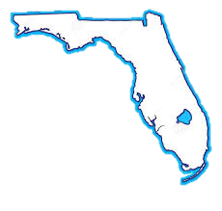
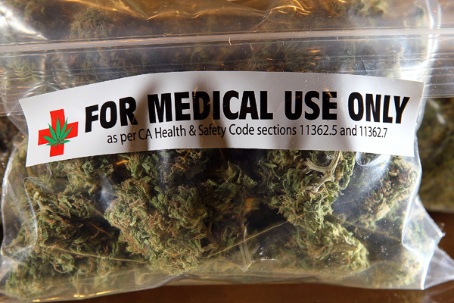
Local Problem
Gov. Scott approves medical marijuana for terminally ill patients
Medical cannabis will be used to ease pain and suffering

Slide 5
BENEFITS OF MARIJUANA
(marijuana kills cancer, 2016)
(marijuana eases pain, 2016)

Slide 6
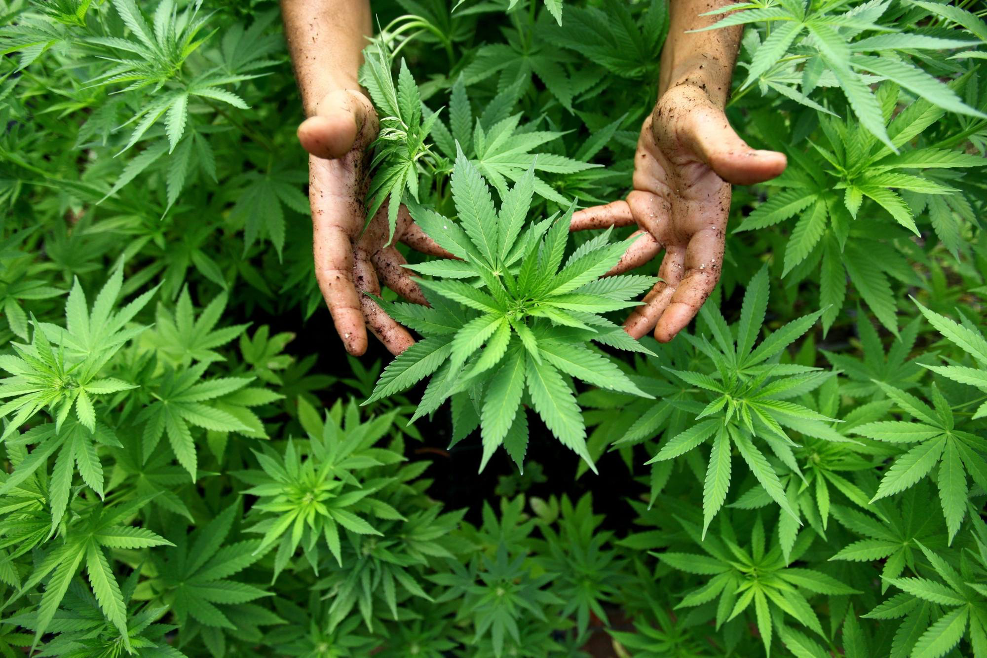
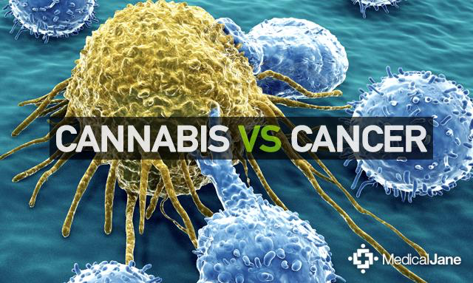
STOPS THE SPREAD OF CANCER

Slide 7
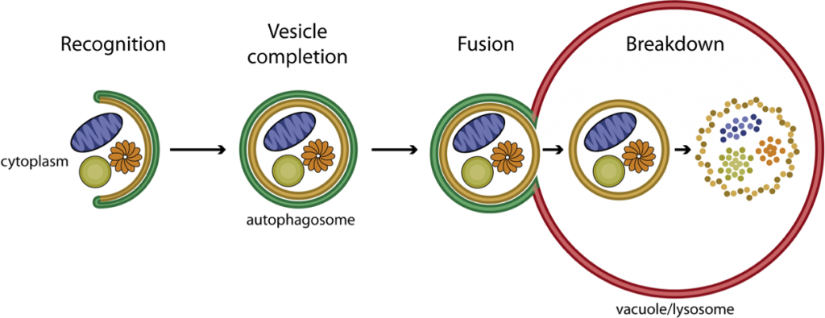
AUTOPHAGY
(Autophagy, 2016)

Slide 8
MARIJUANA EASES PAIN
(Marijuana Patients, 2016)
(Marijuana Patients, 2016)

Slide 9
Just 3 puffs a day of cannabis will help patients with chronic nerve pain
Less pain
Better sleep

Slide 10
5 Days
9.4%
of smoking the highest dose
10% to 15% of patients attending a chronic pain clinic use cannabis as part of there pain control
Pain decreased by more than half it was before

Slide 11
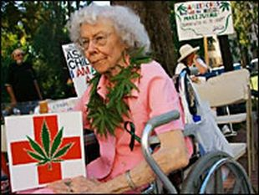

Slide 12
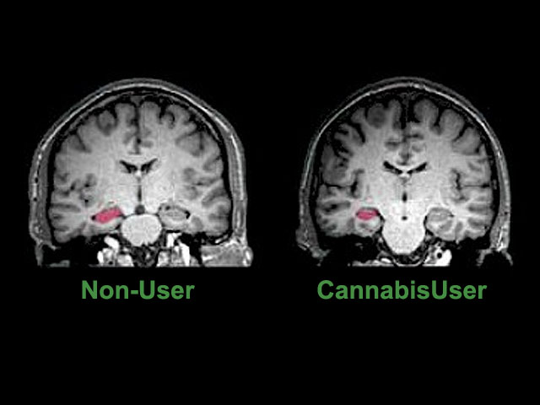
NEGATIVES OF MARIJUANA
(Brain Affects Marijuana, 2016)

Slide 13
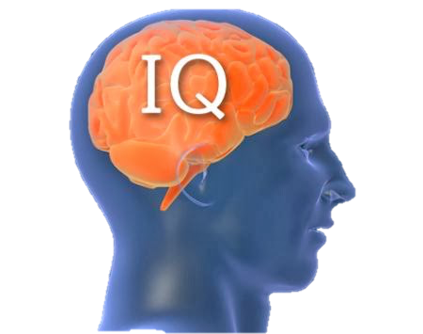
- 8
(Young teenagers smoking weed, 2016)

Slide 14
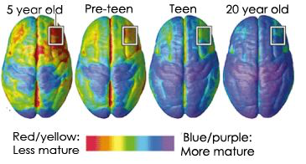
Brain Development
(Brain maturing, 2016)

Slide 15
What is the SOLUTION?

Slide 16
Conclusion

Slide 17
References
BROSIOUS. (2016, March 28). Florida extends medical marijuana to terminally ill patients. Retrieved April 22, 2016, from http://extract.suntimes.com/news/ 10/153/17938/ florida-extends-medical-marijuana-to-terminally-ill-patients
Cannabis 101: THC & CBD Tweet 128Cannabis 101: THC & CBD. (n.d.). Retrieved May 10, 2016, from http://mychronicrelief.com/cannabis-101-thc-cbd/
Dr. Wai Liu. (2014, November 18). Marijuana Drastically Shrinks Aggressive Form Of Brain Cancer, New Study Finds. Retrieved May 10, 2016, from http://www.huffingtonpost.com/ 2014/11/18/marijuana-brain-cancer_n_6181060.html
Marijuana Relieves Chronic Pain, Research Shows. (n.d.). Retrieved April 22, 2016, from http://www.webmd.com/pain-management/news/20100830/marijuana-relieves- chronic-pain-research-show?page=2
McNamee. (n.d.). Cannabis reduces tumor growth in study. Retrieved April 22, 2016, from http:// www.medicalnewstoday.com/articles/279571.php
NIDA. (n.d.). Marijuana. Retrieved April 22, 2016, from https://www.drugabuse.gov/publications/ drugfacts/marijuana

